Slide 1
An Approach to Character Controllers
For DigiPen | Institute of Technology
Randy Gaul

Slide 4
Github Repo for Demo
All code history available
Warning – not the most professional commit log
Step by step process for construction “from scratch”
https://github.com/RandyGaul/player2d

Slide 5
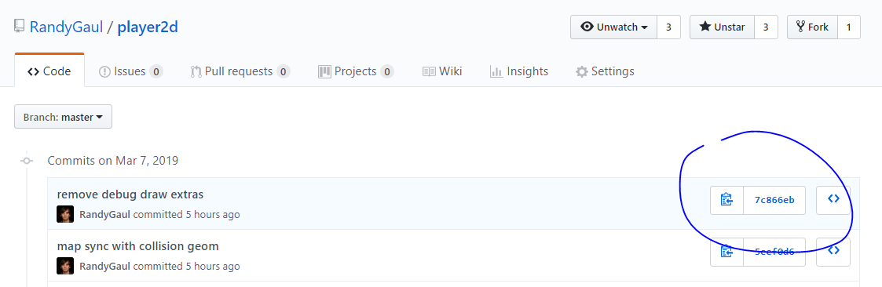
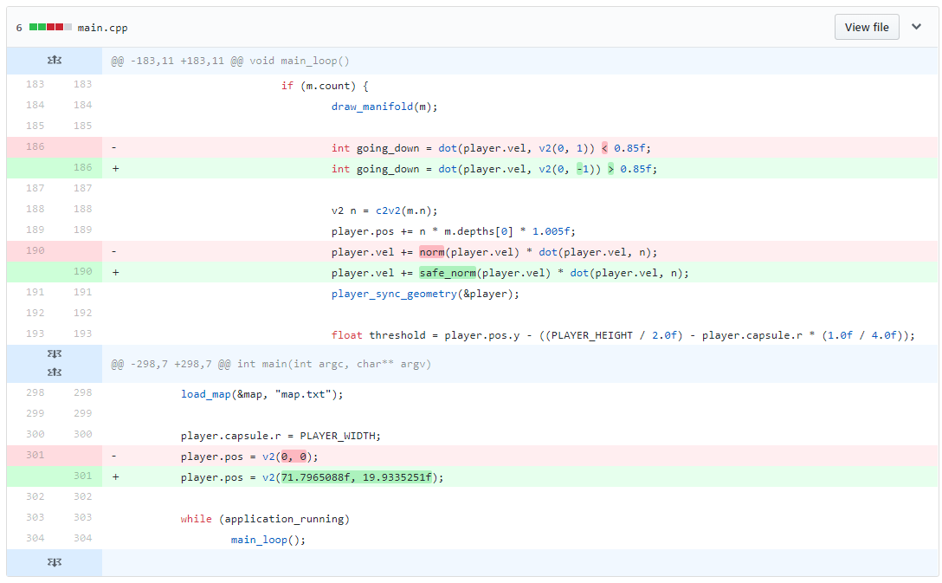
Click on Commits for the Diffs

Slide 6
The Pieces
Detect collisions
Resolve collisions
Share information about collisions
API and Abstraction (the hardest part)

Slide 7
Some Strategies
Pre-built
Intra-physics engine
Custom solution

Slide 8
Pre-Built
Not-full featured
Good starting point
Typically intermingled with a specific technology (dependency)
Devolves into custom solution

Slide 9
Intra Physics Engine
Lots of callbacks
Duplicated state
Physics engine as a dependency

Slide 10
Custom Solution
No dependencies
More easily extended
More reusable
Simpler
Less state duplication and more centralized
Can have "optional" addons (like out-of-the-box support for specific technologies)

Slide 11
Go with a Custom Solution
Choose good algorithms (I'll help)
Choose good constraints and limitations (I'll help)
Design a good API and abstraction (I'll offer some advice, and a barebones example)

Slide 12
Key Observation
The tech is easy
The hard part is _choices_
Which algorithm, what API, what constraint
You're all smart, and can figure the tech out
Spend more time practicing your product development skills
Make a useful tool, and then use it to make a nice product

Slide 13
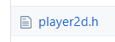
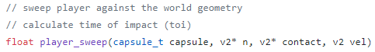
Detecting Collisions
Limit rotations to *none*
Use GJK to implement a Time of Impact solver (TOI)
Solve for the TOI with Conservative Advancement
From GitHub Demo ☺

Slide 14
The Best GJK Reference
Erin’s GJK demo hosted on box2d.org/downloads
GDC 2010

Slide 15
Conservative Advancement
Old algorithm
Originally by Mirtich
Erin’s resource is the best, hosted on box2d.org
GDC 2013

Slide 16

Resolving Collisions
Use Non-linear Gauss Seidel (NGS)
Move positions directly, along solution vector
Gently press shapes apart
Avoid or explicitly handle numerically sensitive scenarios
Acute corners
Squeezing into tight corridors
From GitHub Demo ☺

Slide 17
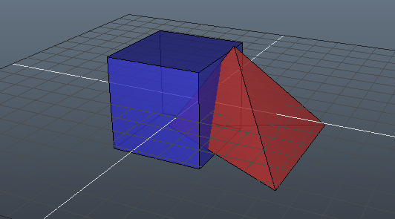
Non-linear Gauss Seidel (NGS)
Requires copious and accurate collision manifold
Best resource is Dirk’s 2013 and 2015 GDC lectures
Box2d.org/downloads
Get the pattern? ☺

Slide 18
The Demo’s Collision Detection
Delegated to cute_c2.h
My own dedicated 2D collision detection header
TOI Solver
Construct Manifolds

Slide 19
Creating a Strong API
Subjective land
The “real meat” of the topic

Slide 20
Useful Tools Ripe for an API
State machines
Enter/Exit conditions
On ground, on slope, is sliding, touching ceiling, hit corner, standing on edge, can duck, can stand up, can open door
Timers
Get ground reference
What happens if I press X (re-entrancy)
Can move forward
Can enter

Slide 21
Identify Isolatable Tools
Minimize dependencies across systems
Collision detection
TOI calculation
Aggregating collision results
Interfacing the above with a specific physics technology (mirroring a trigger volume in the physics engine)
Debug rendering
Player intent layer

Slide 22
Do not Isolate Bad Candidates
Marriage between systems is OK
Data duplication is OK
Code duplication is OK
Game states, rendering, timers, events, animations/states, camera, interpreting player intents
These start getting inter-mingled very easily
Spaghetti it up!

Slide 23
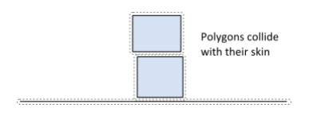
Practical Advice – NGS Skin for TOI
http://box2d.org/manual.pdf

Slide 24
Design of 2D Character Geometry
Capsule is your friend
No catching edges
AABB good too! In special cases
Avoid multiples-of-tiles in size

Slide 25
Practical Advice – No Gravity on Ground
Float/Bounce Problems

Slide 26
No Gravity – TOI Down to Fall

Slide 27
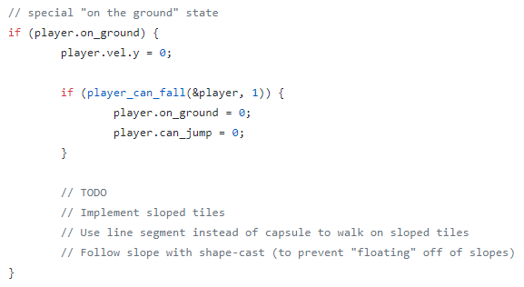
API Case Study – Player Can Fall

Slide 28
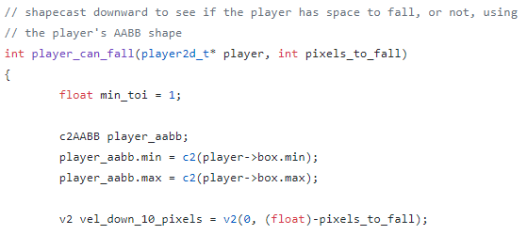
Player Can Fall – Implementation (1)

Slide 29
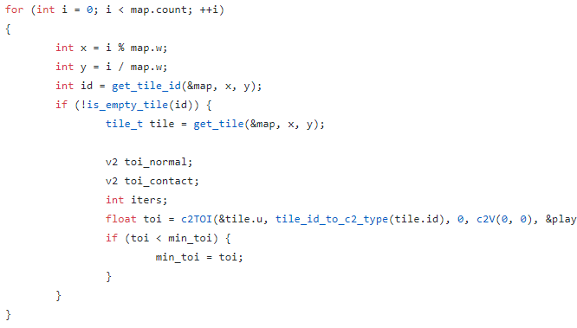
Player Can Fall – Implementation (2)

Slide 30
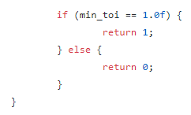
Player Can Fall – Implementation (3)

Slide 31
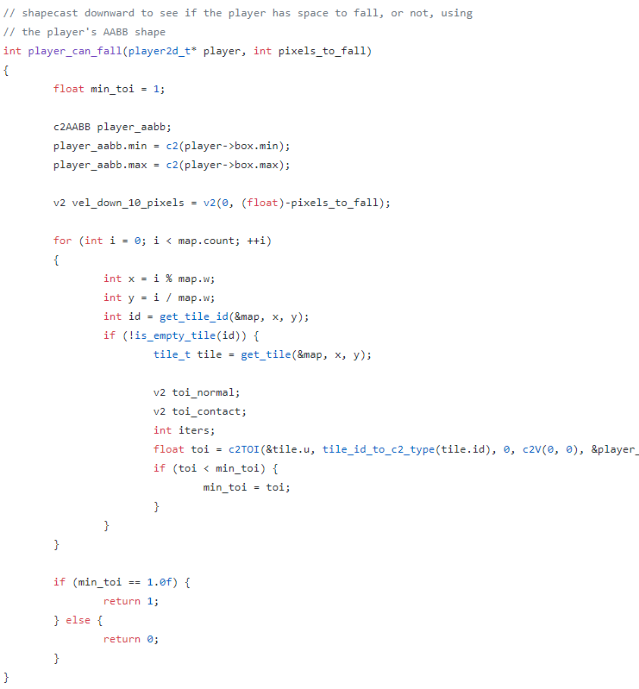
Player Can Fall – Implementation (4)
The entire thing is short!

Slide 32
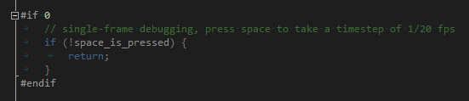
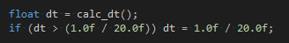
Practical Advice – Single Frame Stepping
Fixed Timestep!

Slide 33
Practical Advice – Fake Inputs via Debugger

Slide 34
Practical Advice – Debug Line Render
Draw all shapes
Draw all contact points
Draw resolution vector scaled by depth

Slide 35
FIN
Q/A TIME!!!

